Slide 1
Fertility Penalties for Flexible Employment
China’s Two-Child Policy and Its Effects on Women in the Workforce
YIDAN QIN

Slide 2
China has entered turning point in the structure of its demography
The imbalance of population structure
Population aging
“Two-child” Policy
Notes:
In the 21st century, China has entered a new turning point in population development. The imbalance of population structure and population aging have become two of the main problems in current society. if the one child policy is still implemented in China, it will plunge the country into an irreversible crisis of population aging. According to the country's seventh national census ，People who aged 60 and over account for 18.70 percent of China’s population, with 13.50 percent of them aged 65 and over. Between 2010 and 2020, the proportion of people aged 60 and over has risen by 5.44 percentage points, as people aged 65 and over has risen by 4.63 percentage points.
In order to adapt to the new situation of population development, the family planning policy, which has remained unchanged for decades, has undergone adjustments. After the “selective two-child ” policy, the two-child” policy has also been launched consecutively.
Retrospectively, the history of the family planning policy shows the main purpose of the policy is to adjust the number and structure of population . During this process, these family planning policies have elevated the private behavior of childbearing from the choice of individuals and families to the country and society，which laid the foundation of the close relation between childbearing and social development issues, such as demographic dividends, population aging, and declining birthrate,in view of the public discussions.

Slide 3
Women and Employment
The development of females, the subjects of childbearing, has been neglected in this heated debate.
Women’s childbearing and childrearing role
tends to disadvantage them in the labour market
is a major factor feeding into their weak position in terms of occupations and earnings
Notes:
While on the contrary, the development of female who are the subjects of childbearing, has been neglected in this heated debate. It is true that childbearing is the motive force and foundation of population and social development, while the nature of sex makes female have to bear the responsibility of childbearing.But in the society where male hold the mainstream discourse power, childbearing seems to be divorced from female. Few mainstream discourses which has the perspective of female, are be discussed when related to the conflicts between childbearing and female’s personal development, as well as the negative impacts on female.
However, women’s childbearing and -rearing role tends to disadvantage them in the
labour market and is a major factor feeding into their weak position in terms of occupations and earnings

Slide 4
Changes in Income
Decreases After Giving Birth
65.7%
annual income
54.9%
hourly wage
Notes:
On average, A mother, after giving birth, her annual income has decreased by 34.3% and the hourly wage has decreased by 45.1%

Slide 5
Motherhood Wage Penalty
The wage losses associated with motherhood
Notes:
The motherhood penalty is a term coined by sociologists who argue that in the workplace, working mothers encounter biological and cultural based disadvantages in pay, perceived competence, and benefits relative to childless women. Specifically, women may suffer a per-child wage penalty, resulting in a pay gap between non-mothers and mothers that is larger than the gap between men and women. Mothers may also suffer worse job-site evaluations indicating that they are less committed to their jobs, less dependable, and less authoritative than non-mothers. Thus, mothers may experience disadvantages in terms of hiring, pay, and daily job experience.
Here are some reasons about why it comes into being.

Slide 6
Motherhood Wage Penalty
1
Childbearing and childrearing interrupt women’s labour force participation.
In the absence of regulations on maternity/paternity leave, women’s intermittent labour force participation reduces their human capital input and therefore lowers their earnings.
Notes:
The motherhood wage penalty can be attributed to various factors. First, in the absence of regulations on maternity/paternity leave, childbearing and -rearing interrupts women’s labour force participation, and women’s intermittent labour force participation reduces their human capital investment and therefore lowers their earnings

Slide 7
Motherhood Wage Penalty
2
Women need to take time to take care of their children.
This restricts mothers to types of paid work that are easier to combine with parenting, such as part-time work and home-based work.
Notes:
Second, childrearing often restricts mothers to types of paid work that are easier to combine with parenting, such as part-time work and home-based work ，which is flexible to take care of their babies, but lower income.

Slide 8
Motherhood wage penalty
3
It takes time and energy to raise a child.
The time and energy devoted to childrearing inevitably reduce the amount of effort available for them to devote to paid work.
Notes:
Third, the book named <A Treatise on the Family,> shows mothers may earn less because the time and energy devoted to childrearing inevitably reduce the amount of effort available for them to devote to paid work

Slide 9
Motherhood Wage Penalty
4
Having young children limits mothers’ labour-market mobility
Women are underrepresented in the trade union sector
Mothers have less bargaining power, are vulnerable to monopolistic exploitation, and receive poor labour-market protection.
Notes:
Fourth, mothers have less bargaining power, in part because having young children limits mothers’ labour market mobility and consequently makes them vulnerable to monopolistic exploitation, and in part because women are underrepresented in the trade union sector so its especially hard for them to receive labour market protection and guarantee their wages.

Slide 10
Motherhood Wage Penalty
5
The belief that mothers always allow domestic responsibilities to interrupt their paid work means that
employers may discriminate against mothers in hiring and promotion.
The earnings losses associated with motherhood are an important source of gender earnings inequality.
Notes:
Lastly, the research in 1988 shows, believing that mothers always allow domestic responsibilities to interrupt their paid work, employers may discriminate against mothers in hiring and promotion (Waldfogel, 1998B). The earnings losses associated with motherhood are an important source of gender earnings inequality

Slide 11
Motherhood Wage Penalty in China
Before the Reform and Opening Up
After the Reform and Opening Up
Notes:
The following is an introduction to the current status of fertility penalties in China. There are certain disparity in the social and economic system and mainstream ideas in China before and after the reform and opening up, which leads to different fertility penalties for females. Therefore, we divide the introduction into pre and after the reform and opening up.
Marxist view of women’s emancipation is contingent on women’s participation in socialised labour,
women’s full participation in the labour force played a key role in the leadership’s attempt
to alleviate discrimination against women in society

Slide 12
Before the Reform and Opening Up
SOEs | State-owned enterprise wages were determined predominantly on the basis of workers’ education and seniority.
Communism | Inspired by the Marxist view of women’s emancipation, society is relies on women’s participation in socialised labour.
Childcare facilities | The childcare system provided care to children from the earliest months of their lives until they entered primary school.
Wage gap | The costs of social reproduction under central planning were not solely borne by women; the wage penalty for motherhood was small or non-existent under central planning.
Notes:
First Under central planning, China’s urban labour market was known as an ‘iron rice bowl’ with ‘everyone eating from one big pot’. Workers in state enterprises were employed for life and paid according to centrally regulated wage scales that were determined predominantly on the basis of workers’ education and seniority
Second Marxist view of women’s emancipation is contingent on women’s participation in socialised labour, women’s full participation in the labour force played a key role in the leadership’s attempt
to alleviate discrimination against women in society.That is why China strongly supported
females accessible to employment at that time.
Third Most working-age women in the urban sector were employed full-time after school graduation. To support working mothers, resources were devoted to a publicly funded childcare system that provided care to children from the earliest months of their lives until they entered primary schools (He and Jiang, 2008). In addition to on-site childcare, the employers also provided working mothers with nursing rooms for breastfeeding and paid maternity/family leave. For example, some kindergartens are named after its relative authorities , which indicates that this kindergarten in the past was established to provide employees with childcare benefits. For example, some kindergartens are named after its relative authorities , which indicates that this kindergarten in the past was established to provide employees with childcare benefits.
These family-friendly policies made it easier for mothers to combine paid work with domestic responsibilities, thereby minimising the degree to which childbearing and -rearing interrupted women’s workforce participation. Although women remained the principal caregivers for children and other family members and their domestic burdens had the potential to leave them exhausted or distracted at work, the impact of work effort on earnings was limited because the wage differentials among workers were compressed (Meng and Kidd, 1997). In essence, the costs of social reproduction under central planning were not solely borne by women; the state and employers footed part of the bill. As a result, the wage penalty for motherhood was to be small or non-existent under central planning.

Slide 13
After the Reform and Opening Up
Wage gap | Enterprises are increasingly relying on piece rate wages and performance-based bonus payments which disadvantage mothers.
Maternity protection measures | The reforms dismantled the institutional mechanisms that had internalised the costs of social reproduction and protected working mothers under central planning.
Childcare facilities
Substantial cutbacks were made in the support provided by the government and employers for childcare.
Notes:
Of those seen in transition economies, China’s reforms are some of the most successful; they have produced impressive rates of economic growth and massive poverty reduction .However, an unintended consequence of the SOE-sector restructuring is that the reforms dismantled the institutional mechanisms that had internalised the costs of social reproduction and protected working mothers under central planning, and did not create adequate measures to replace them.
Undoubtedly, the Chinese government has passed a series of regulations to protect women against labour market discrimination in the post-reform era. For instance, the new labour law stipulates that women and men have equal employment rights, female employees are entitled to a 90-day maternity leave, and no employer should lay off female employees, lower their wages or unilaterally terminate their labour contracts for reasons of marriage, pregnancy, maternity leave or breastfeed-Ing.
Although these ‘mother-friendly’ regulations have been implemented in govern-ment agencies, non-profits, public organisations and large SOEs, they have been largely ignored by private employers. There are no effective mechanisms to protect mothers from being adversely affected by market discipline and discriminatory practices in the private sector.
Moreover, under pressure to increase profits, enterprises are increasingly relying on piece rate wages and performance-based bonus payments to elicit effort and discourage absenteeism. These competitive compensation schemes tend to disadvantage mothers, because childbearing and rearing responsibilities decrease the time and energy that they have available for paid work and thereby hinder their job performance.
Another far-reaching change following the SOE-sector restructuring has been the substantial cutback in the support provided by the government and employers for child-care. With the drive for efficiency, the vast majority of Chinese enterprises ceased to offer subsidised childcare to employees.

Slide 14
After the Reform and Opening Up
With the drive for efficiency, the vast majority of Chinese enterprises ceased to offer subsidised childcare to employees.
A Chinese firm social responsibility survey undertaken in 2006：
Notes:
But According to the Chinese firm social responsibility survey undertaken in 2006, enterprises with kindergartens hasn’t accounted for 20% of all state owned enterprises , and as for all types of enterprises there are only 5% of them are equipped with kindergartens. Publicly funded nurseries for children aged up to two years have become largely non-existent.

Slide 15
After the Reform and Opening Up
With the exception of employees of government agencies, non-profit public organisations continued to provide subsidised childcare, but most urban parents have had to rely on service-for-fee childcare programmes to meet their needs. Thus it has become increasingly difficult for mothers with young children to participate in the labour force.
Notes:
With the exception of employees of government agencies, non-profit public organisations continued to provide subsidised childcare, urban parents have had to rely on service-for-fee child-care programmes to meet their needs. Thus it has become increasingly difficult for mothers with young children to participate in the labour force. Maurer-Fazio et al. (2009) present evidence that the labour force participation rate for urban women with pre school age children fell dramatically between 1990 and 2000, and that residence with grandparents became increasingly important for women looking to stay in the labour force.
Du and Dong (2010) find that the sharpest decline in labour force participation occurred
among women with children younger than three years of age. Additionally, a growing
number of urban women have been pushed into the informal sector in which jobs are typically temporary or part-time, insecure and low paying

Slide 16
After the Reform and Opening Up
Research from Maurer-Fazio presents evidence that the labour force participation rate for urban women with pre-school age children fell dramatically between 1990 and 2000.
Notes:
With the exception of employees of government agencies, non-profit public organisations continued to provide subsidised childcare, urban parents have had to rely on service-for-fee child-care programmes to meet their needs. Thus it has become increasingly difficult for mothers with young children to participate in the labour force.
We can see on the picture presenting the evidence that the labour force participation rate for urban women with pre school age children fell dramatically between 1990 and 2000, and that residence with grandparents became increasingly important for women looking to stay in the labour force.
Some research find that the sharpest decline in labour force participation occurred
among women with children younger than three years of age. Additionally, a growing
number of urban women have been pushed into the informal sector in which jobs are typically temporary or part-time, insecure and low paying

Slide 17
Motherhood wage penalty in China
Widen the wage gap between mothers and childless women
Pushing mothers into flexible employment
Notes:
Thus, privatisation and labour market deregulation associated with the SOE-sector
restructuring are expected to widen the wage gap between mothers and childless women by
increasing birth-related workforce interruptions, exacerbating the impediments of
childbearing and -rearing to mothers’ opportunities for on-the-job training or promotion,
tightening the link between earnings and job performance, and pushing mothers into the
types of jobs that offer more flexibility but lower pay

Slide 18
Flexible Employment

Slide 19
Flexible Employment
Large numbers of jobs have been replaced by machines, while some enterprises have laid off workers and many have chosen flexible employment.
Flexible employment is the same as informal employment in economics and is usually measured by whether medical insurance and pension insurance are provided, and whether a contract is signed.
In 2016 the number of informal workers in urban areas had become 215 million: most of them are laid-off workers and females are in the majority of the laid-off group.
informal workers
Total number of urban population
Notes:
In the process of economic globalization, the degree of production automation in some industries is soaring, which in a certain extent will cause a large number of workers laid off.
The structural unemployment becomes even a more serious case for some poorly educated and unskilled workers. Consequently, some companies have turned regular employees into piece workers or temporary workers with no minimum wage, social security or welfare, while female workers, who often with lower levels of education, Raising children consumes them a great deal of energy，have borne the brunt of production automation in this process.

Slide 20
Flexible Employment
Notes:
The data reflects the average housework time of males and females . It can be seen that urban females spend 1.8 times more housework time than males, while rural females spend 2.3 times more housework time than males, nearly three hours more than males.
Therefore females, especially middle-aged groups, as adapting to economic globalization, often become the main target of layoffs in enterprises. As a result, females are confronting double burdens —— on the one hand, they need to gain earnings to support their families
(especially if their husbands also face unemployment), and on the other hand, because of lower income and the higher child care prices and limited access to child care services， the ability of relying on social services to reduce housework is enormously reduced, so that females need to bear a heavier burden of housework, which ends with increasing constraints on their paid work time. In this case, informal employment, characterized by flexible working hours and more freedom in deciding when to and off work, turns to be the only way for these females.

Slide 21
Flexible Employment
A recent survey by the Ministry of Women Workers of the All-China Federation of Trade Unions（ACFTU）of 660 enterprises had the following findings.
Real reason: Females giving birth to babies and nurturing children will have a negative impact on the economic interests of enterprises.
unwilling to recruit female workers
According to a survey of 200 corporations in 2010, non-breastfeeding female workers generated an average of 4420.3 yuan more profit per year than breastfeeding female workers.
More females are hunting for jobs in the informal job market.
Notes:
At present, in China standardized employment management on informal employment is often lacked. For instances, social security and protection of labor rights in informal employment is low in level, and labor relations management based on labor hours is not implemented. Most informal workers are excluded from urban social security systems such as unemployment insurance and maternity insurance. Low income, long working hours and housework force informal employed females not only fall into "economic poverty", but also into "time poverty". Under the same conditions as males, females are more likely to participate in informal employment, which means there are more females entering the low-end job market without social protection, making females more vulnerable than men in the aspects of development. Gender gap within informal employment may further marginalize females at the lower end of the labour market.

Slide 22
Flexible Employment
In a survey of 1,230 enterprises, a female worker was on average twice as likely as a male worker to lose their job and be laid off.

Slide 23
Flexible Employment
The wage gap between males and females has increasingly widened.
Most of these females:
Engage in low-skilled and low-income work, i.e.. flexible employment
Face less labour security
Fertility penalties in flexible employment can be higher than those for males
Notes:
while in recent years the wage gap between males and females has increasingly widened, from 77.5 percent in 1990 to 70 percent in 2010.Most of these females are employed in low-skilled and low-paid jobs in flexible employment, and at the same time they face less labour security, while fertility penalties in flexible employment can be higher than those for males.
First of all, when economic crisis is raging and economic system is reforming, with the circumstance that few or even no formal jobs are provided, numerous job seekers can only find jobs in informal employment areas. As more male job hunters seek jobs in the informal job market, the lowest rank of informal employment area is where females are pushed(111). Especially at present, high-tech is applied widely, which requires more high-tech jobs, while males usually have more opportunities for access, females doom to enter the lower level of the informal economy(112).
Secondly, in informal employment area, since the sex gap is existent in the division of labor, females are at the bottom of the area, and the gender segregation of industries and occupations does have an important impact on the income of male and female informal workers. As average income of informal workers is lower than the average income of regular workers, and the gender pay gap for informal workers is larger than that for regular workers, the income gap between the two sexes is further widened, which determines the lower economic status of females in general than male, bringing females to the margin of the low-end labor market in society.
Finally, females find jobs in informal employment are at risk of falling into poverty because of inadequate social welfare, medical care and social security. In fact, the society and protection of informal workers have always been a critical issue in the study of informal employment. Informal workers not only face job and income instability, but also occupational safety and health risks, while females who engage in informal employment are more vulnerable and less protected. The fertility penalty faced by females is often more severe.

Slide 24
Flexible Employment
Demonstrated by a survey conducted in 2007, among the 9,063 female workers working flexibly:
Notes:
Briefly, demonstrated by the survey in 2007, among the 9,063 female workers working flexibly, 54.5% did not sign labor contracts with employers, 60.8% paid without pension and health insurance, 57.7% had no day-off on statutory holidays, 23.6% did not get overtime pay, and 2.4% responded that boss has sexually harassed female employees in enterprises.

Slide 25
Family Planning Policy

Slide 26
Family Planning Policy
Disadvantages ：caused problems such as serious imbalance in the sex ratio at birth
Notes:
On the one hand, during the implementation of the “one-child” family planning policy, the “one-and-a-half child” policy in some regions reflects the tradition of male gender preference, while the discrimination against female reflected in the policy is not conducive to promoting gender equality, which has also caused problems such as serious imbalance in the sex ratio at birth.

Slide 27
Family Planning Policy
Advantages ：
Liberated females from heavy burden of frequent childbearing and childrearing
improved their education level
Notes:
But on the other hand, the status of female has been potentially improved by the implementation of “one child”family planning policy. By the means of compulsory "one-child" family planning policy, female actually have gotten rid of the heavy burden of frequent child bearing and rearing,and thus they are able to spend more time and energy in learning scientific and cultural knowledge, participating in social and economic activities, and enabling themselves with higher degree of economic independence. At the same time, the improvement of female's education level, as well as social and economic status, has also benefited the implementing of family planning policy and the birthrate was reduced. It is true that although the original goal of implementing family planning policy was not to improve female's social status, but consequently, female are free from frequent childbearing, and obtain time and opportunities for personal development. In decades, the significant improvement of education level and social status of Chinese female has been witnessed.

Slide 28
Family Planning Policy
Since 2013, China had revised its family planning policy to the two-child policy, but it did
not achieve the expected results. As the society evolves, more females pay attention to the progress of their own careers, while childbirth is likely to hinder that pursuit.
Notes:
In recent years, to accommodate the new situation of population development, the family planning policy has been reformed from “two-child”policy for only-child parents and“selective two-child”policy to “two-child”policy, which marks that the family planning policy has entered a new historical stage. However, judging from the embarrassing situation of the previous "selective two-child " policy, the reform of the family planning policy was too far from the expected goal. This is because with the improvement of female social status, more and more female begin to pay attention to their own career development.
However, the current family planning policy ignores the conflicts between childbearing and personal development confronted by female as the subject of childbearing. On the one hand, the “selective two-child”policy hinders female from balancing their own development and giving birth to a second child. On the other hand, the policy itself produces little effect.

Slide 29
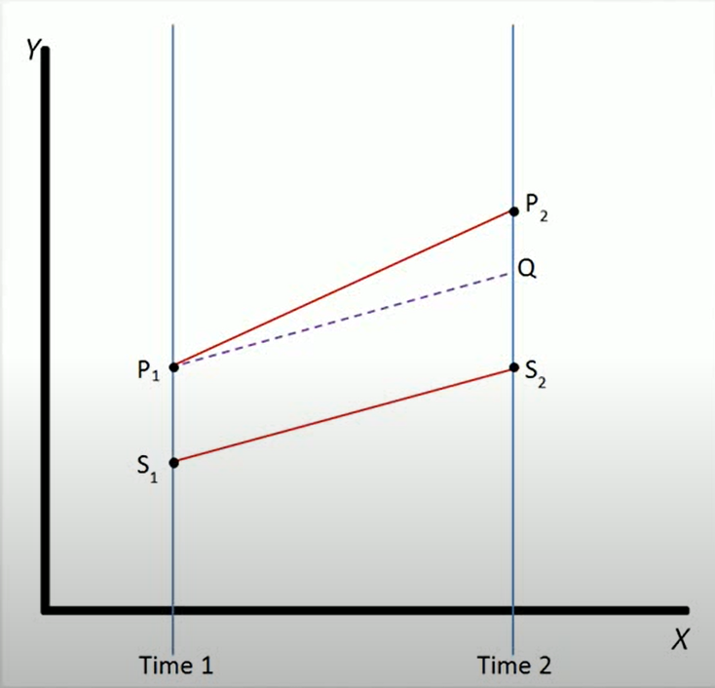
Difference in Difference
Notes:
In the light of the above information, known by us are both the negative impact of fertility penalties on the career of a mother, and the lack of security for females in informal employment. So a question is emerged—— Will females in informal employment be more affected considering the second child policy of China? I have compared the data from the cgss database for 2013 and 2017 to build a did model for quantitative analysis. Here we will introduce the did model briefly.
Difference in differences is a statistical technique used in econometrics and quantitative sociology that attempts to mimic an experimental research. Design using observational study. Data. It calculates the effective treatment on an outcome, by comparing the average change over time in the outcome variable for the treatment group, too. The average change over time for the control group. This method may be subjects for certain biases, although it is intended to eliminate some of the effects of selection bias. In contrast to a within subjects estimate of the treatment effect, or between subjects estimate of the treatment effect. It measures the difference in the differences between the treatment and control group over time. General definition, Difference in differences requires data measured at two or more different time periods. In the example pictured, the treatment group is represented by the line P and the control group is represented by the line S. Both groups are measured on the out came variable at time one before either group has received the treatment represented by the point s. P, S, one. The treatment group then receives or experiences the treatment, and both groups are again measured after this, at time two. Not all of the difference between the treatment and control groups, at times two, can be explained as being an effect of the treatment. Because the treatment group and control group did not start out at the same point at time, one. It did therefore calculate the normal difference in the outcome variable between the two groups represented by the dotted line The treatment effect is the difference between the observed outcome and their normal outcome.

Slide 30
Group : female, have given birth with low-skilled flexible employment →1
female, haven’t given birth with low-skilled flexible employment →0
Policy in 2013 → 0 in 2017 → 1
Policy group: female, have given birth with low-skilled flexible employment 2017 →1
otherwise→0
The dependent variable: wages
the independent variable: the policy, group, and policy group.
control variables: rregion, age, cognitive ability, length of service, whether the person is an only child or not, and educational background
Notes:
group here is defined as the virtual variable. When the group represents females who have been given birth with low skilled job in flexible employment, we set the variable to 1, and set the variable to 0 when the comparison group is females with no child doing low skilled work in flexible employment.
Policy is the virtual variable, when in 2013, the two-child policy was not implemented, the variable is 0, and it changes to be 1, four years after 2017, the year that the two-child policy was implemented.
Policy group is the virtual variable. The variable is 1 when the policy group is females who have given birth with low-skilled flexible employment in 2017; otherwise the variable is 0.
The dependent variable is the wage, and the independent variable are the policy, group, and policy group. Region, age, cognitive ability, length of service, whether the person is only child or not, and education background are control variables.
The software Stata will be employed to make measurement analysis.

Slide 31
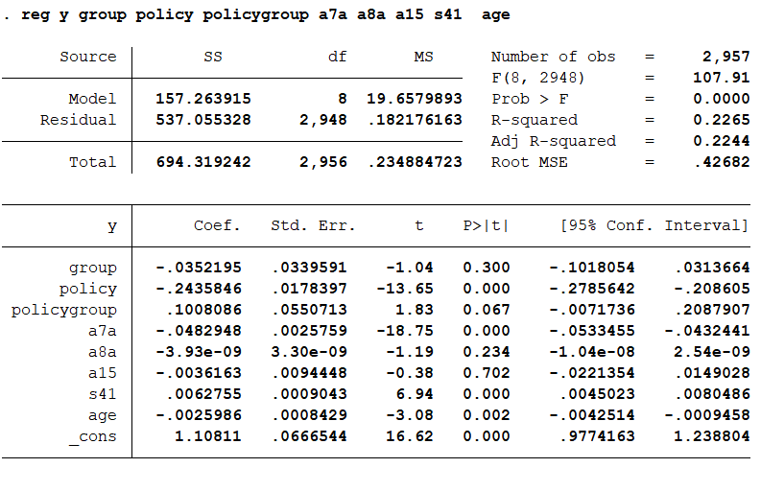
Notes:
The result are shown as follows:
You can find that the t-value in the policy group column is bigger than xx, and it means that with 100 percent of certainty we can overthrow original assumption, which is the promulgation of the two-child policy has a significantly negative impact on the wages of married and pregnant females. The impact may come from married females distracting their energy because of children, and from concerns in the job market about a mother may once bear another child, which both weaken females' bargaining power in the market and ultimately lead to greater fertility penalties for them.

Slide 32
What Should We Do?

Slide 33
Possible Policy Measures
1 Improve the relevant laws and regulations to protect the flexible employment rights and the welfare of females.
2 Reduce the childbearing cost and encourage second-child births by:
①improving public facilities
② learning from foreign experience
③the state appropriately subsidising the childbearing costs paid by enterprises for female workers
④allowing humanised maternity/paternity leave and thereby encouraging fathers to assume parental responsibilities
Notes:
Therefor, we are supposed to:
1.Improving the relevant laws and regulations to protect the flexible employment rights and welfare of females. The relevant welfare policies of China should include clearer indicators with operability, so as to better solve the hidden gender discrimination in employment, and reduce the probability of enterprises utilizing loopholes in policy. It is also plausible, by drawing on foreign legislation, specialized law, institutions , targeted legal mechanisms will be set up and new legal theories will be developed. Only on the basis of better protection of females’ employment rights, the policy of "full second-child policy " can be implemented more smoothly
2 Reducing the childbearing cost and encouraging second- child birth. The pre-condition of China to encourage second-child birth will be publishing corresponding subsidy measures, not only conducive to the "quantity" but also the "quality" of the population. Specific proposals are as follows: (1) improving public facilities, such as public nurseries, public early childhood education, rural kindergarten infrastructure and teachers allocation so on so forth., to reduce the education cost for families;
2) Learning from foreign experience. For couples who have two children, individual income tax can be reduced or removed appropriately, in order to reduce the burden of raising children in two-child-family;
(3) The State can appropriately subsidize the childbearing costs paid by enterprises for female workers, so as to reduce the burden on enterprises, and eliminate the worries of enterprises in hiring female workers;
(4) Allowing humanized maternity leave. Parental leave for males may be set up to reduce the phenomenon of "pregnancy discrimination" towards females, and thus to encourage fathers to assume parental responsibilities
The reason for the failure to achieve greater significance may owing to that many females with children have returned to their families, they from employed to unemployed, but this group is not included in the study data, and only females who have informal occupations are included. In the future, I will refine this data to figure out whether it will increase the significance of the results.

Slide 34
THANKS!

